Slide 1
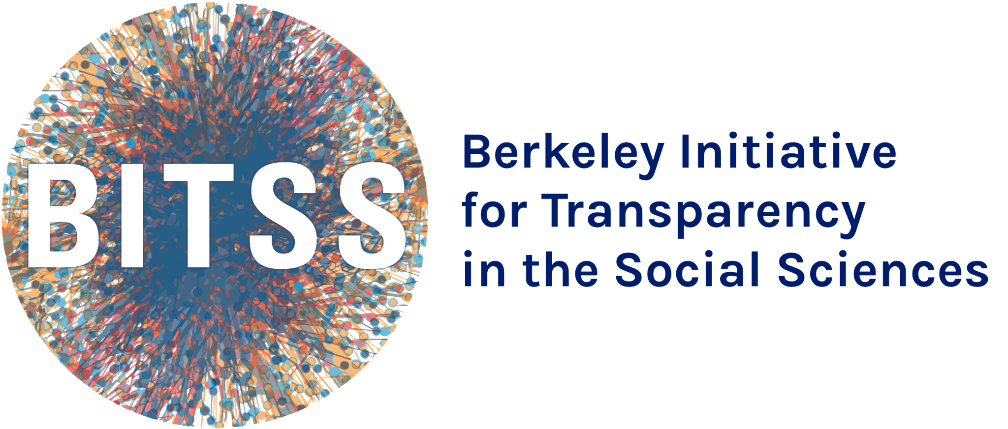
Welcome to the 13th BITSS Annual Meeting!

Slide 2
Established in
2012
Mission Statement
The Berkeley Initiative for Transparency in the Social Sciences works to improve the credibility of science by advancing transparency, reproducibility, rigor, and ethics in research.
An initiative of

Slide 3
Increase access to open science education, building capacity to recognize and conduct transparent and reproducible science through training, access to curricula, financial support, and a growing network of advocates.
Generate evidence on problems and solutions in science through meta-research led by BITSS investigators and our broader community.
1
2
What we do
Strengthen the scientific ecosystem, enabling researchers and institutions to effectively and equitably change norms at scale through open science policy and protocol development.
3

Slide 4
New at

Slide 5
Open Science Education: Research Transparency & Reproducibility Training
May 21-23, 2025
RT2 2024 Participants

Slide 6
Generating Evidence:
Reporting Guidelines for Publication Bias
Measuring publication bias using the American Economic Association (AEA) RCT Registry.

Slide 7
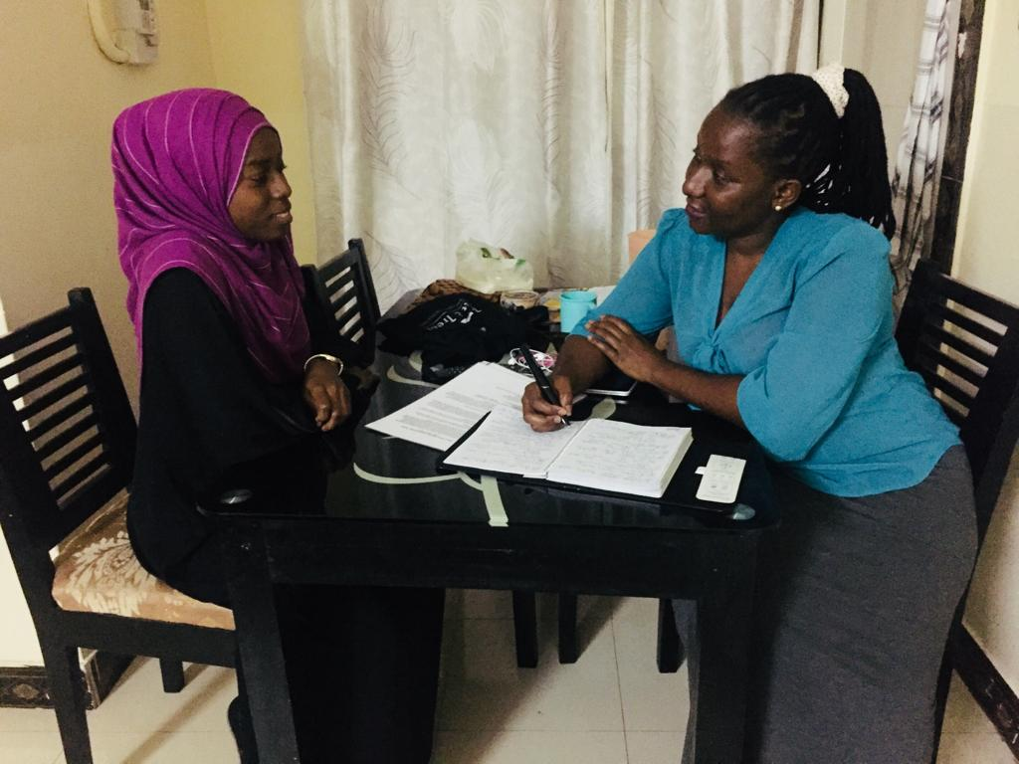
Access to Evidence: Ethics of Sharing Results with Research Participants
ER2 is establishing best practices for sharing results in development economics.

Slide 8
Access to Evidence: Impact Data and Evidence Aggregation Library (IDEAL)
IDEAL aims to standardize results, effect sizes, and contextual information from RCTs.

Slide 9
Open Science Ecosystem: Social Science Prediction Platform (SSPP)
Facilitates the systematic collection and assessment of forecasts of social science research results.
106
Projects on the platform
9,814
Surveys taken to-date
3,303
Unique forecasters

Slide 10
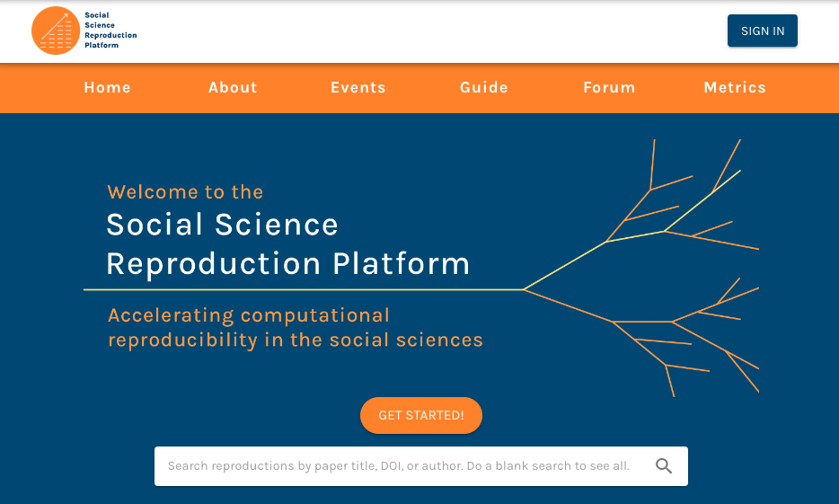
Open Science Ecosystem:
Social Science Reproduction Platform (SSRP)

Slide 11
Open Science Ecosystem: MetaArXiv
A preprint server of articles focused on improving research transparency and reproducibility

